Slide 1

Men vs. Women
Who rules the sky (and beyond) when it comes to NASA hiring rates?
Kaity Tainer, Cynthia Cardenas, Elesha Hunter, Kendra Sawyer, Rachael Reich, Stacey Gonzalez

Slide 2


Rachael Reich
BA Mechanical Engineering
Rachael is from NJ. She obtained her Bachelor’s degree from Drexel University in Mechanical Engineering in 2017. After three years in the semiconductor industry she transitioned to Data Science.

Slide 3

Cynthia Cardenas
BA Elementary Education (University of South Florida)
Currently employed as a first grade teacher

Slide 4

Elesha Hunter

Slide 5

Kendra Sawyer
BS Music Education (Elizabeth City State University)
Currently employed as an Elementary Music Teacher

Slide 6

Stacey Gonzalez
BA Political Science
BS Sociology
MS Psychology MPH Public Health and Epidemiology
Phd International Psychology
Massive Incident Reaction Team certification from Homeland Security
Retired Commander of the United States Army Air Defense Artillery Certified Officer of the Philadelphia Police Department and Critical Incident and Trauma certification.
NCIC / PCIC certification, SQL certification, Bias and Diversity certification from the Anti-Defamation League

Slide 7

Kaity Tainer
BA Psychology (University of Washington, 2016)
USPA Member (2016)
Currently Employed: Electrician
Past employment:
Executive Assistant

Slide 8
Background
Due to direction from President Eisenhower NASA suggested astronauts be chosen from military
test pilots
We can see from 1959-1980 65% came from the military
Overall less women come from the military
The 1970s was a stepping stone that lead women a step closer to becoming astronauts. At the
same time, the military began accepting women for pilot training that eventually led to women
astronauts.[2] In 1977, the recruitment of NASA skyrocketed because of Nichelle Nichols's help.[3]
Part of the advantage Nichols had in the recruitment was that her role as Lieutenant Uhura on Star
Trek inspired young girls to become astronauts at NASA when they grow up.[3]

Slide 9
Background
The 70’s: a springboard for women in astronomy
Women had worked behind the scenes since 1922
Cinema popularized women in the field
A popular one: Star Trek

Slide 10
Methods
Data was gathered from the NASA website
•Data includes information on 714,193 astronauts. (sample size)
Wrangle Data
•We took multiple data sets and combined them in order to run our
analysis
•We dropped unnecessary data
•Dropped missing data
•Square root space walk and space flight (hr) in order for it to meet
the normal distribution assumption for an independent t test

Slide 11
Variables
Age- mean: 38.158317, std: 7.615960, min: 24.5995,
max: 73.5633
•Education- mean- 7.548
•Space Flights- mean: 2.3599
•Space Flights (hr)- mean: 1210.822
•Space Walks- mean: 1.322
•Males Accepted in NASA Program- mean: 60.037
•Females Accepted in NASA Program- mean: 12.444
•Budget

Slide 12
Specific Methods Used:
Python
Independent t-test
Correlation matrix
Linear Regression
Tableau

Slide 13
Evaluation Questions
What is the difference between the hiring rate of males and females that are admitted into the NASA program in the last 10 years?
What is the ratio of males to females that are sent on space missions?

Slide 14
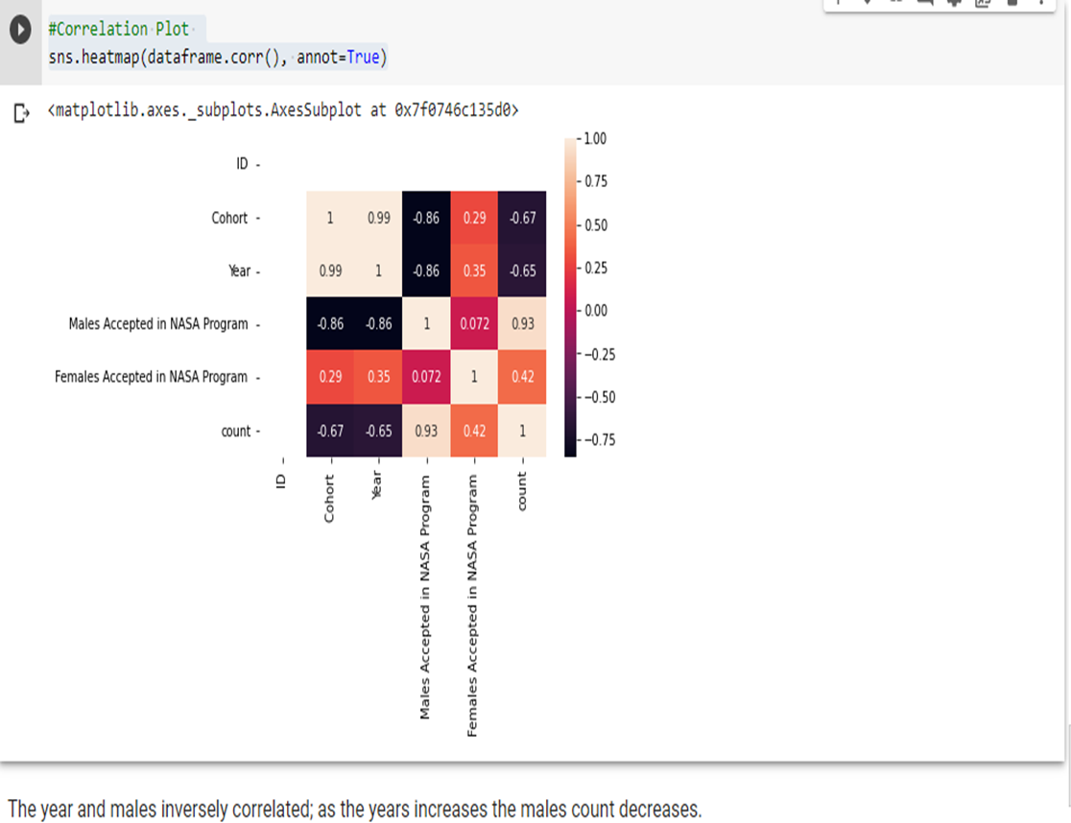
Correlations

Slide 15
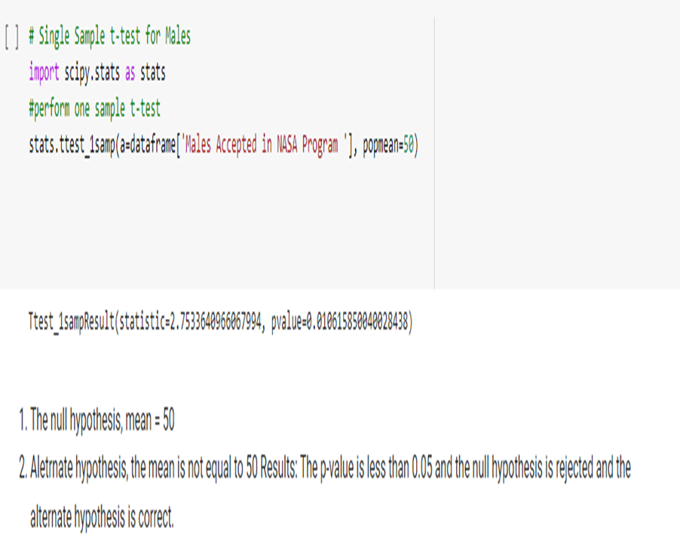
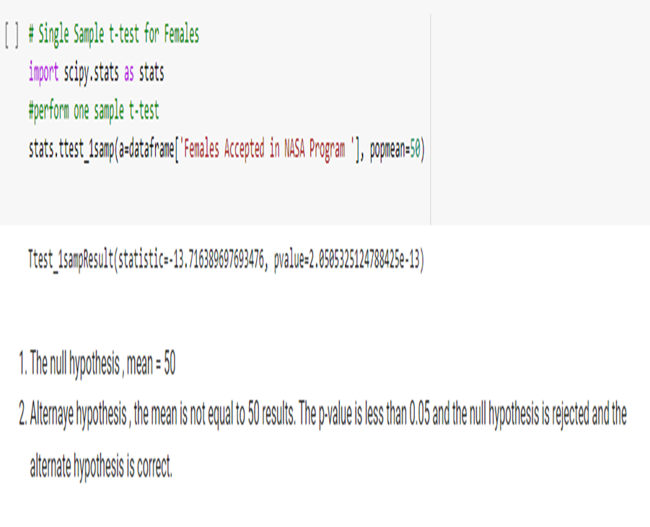
Simple Sample T Test
For males
For females

Slide 16
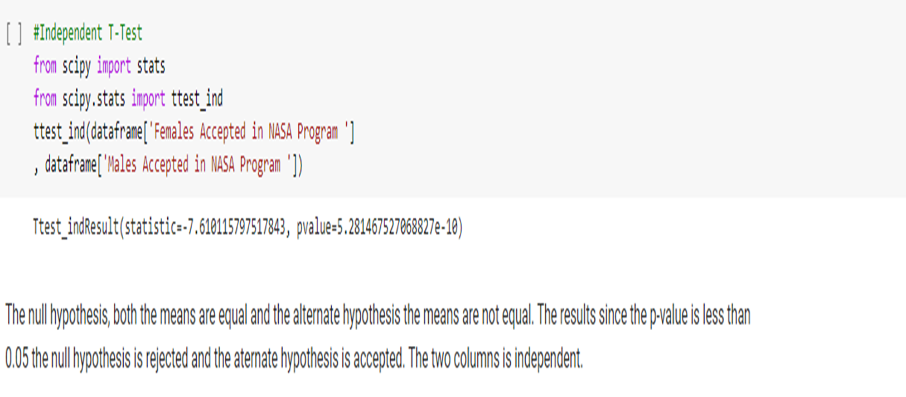
Independent T Test

Slide 17
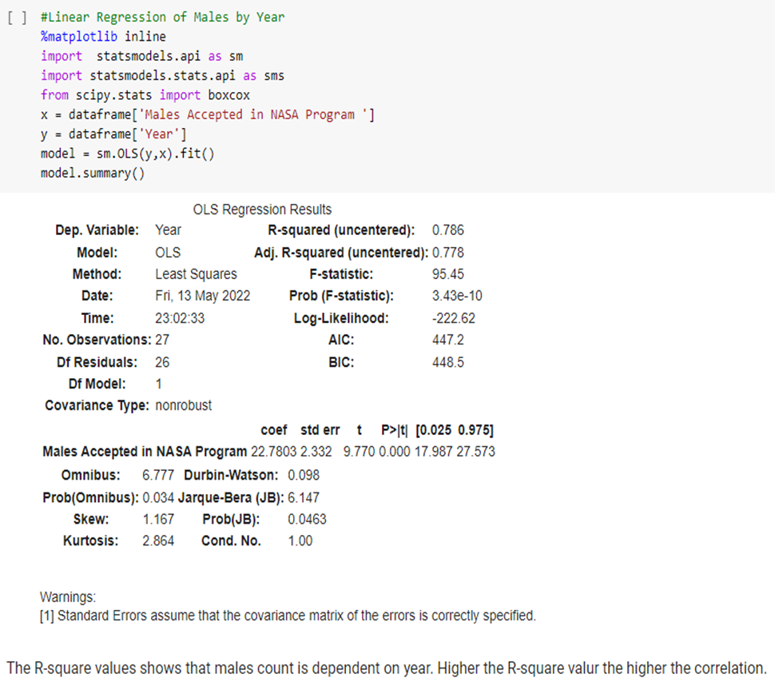
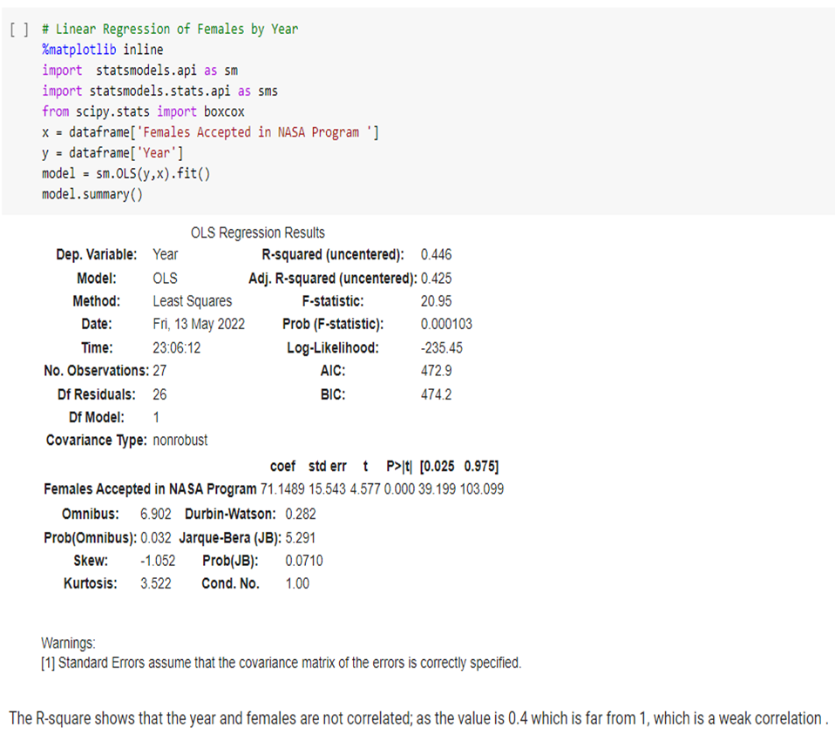
Linear Regression
Males by year
Females by year

Slide 18
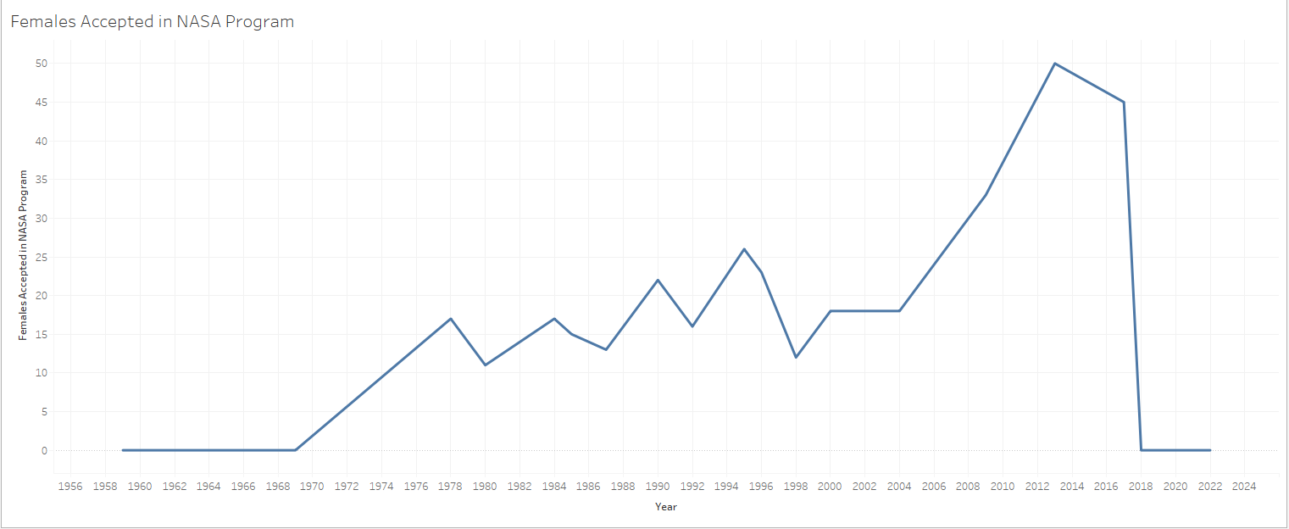
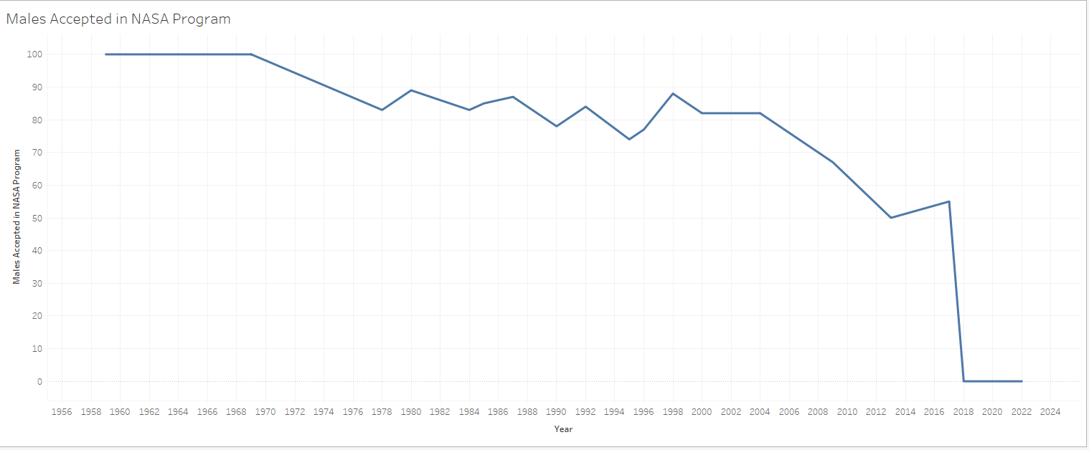

Slide 19
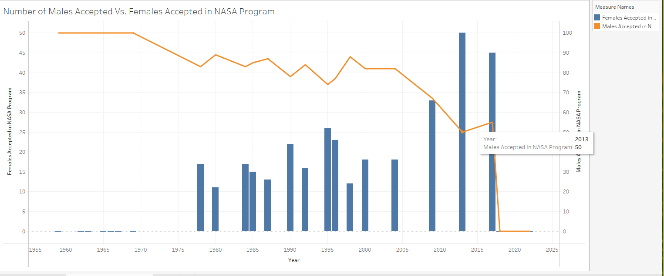

Slide 20
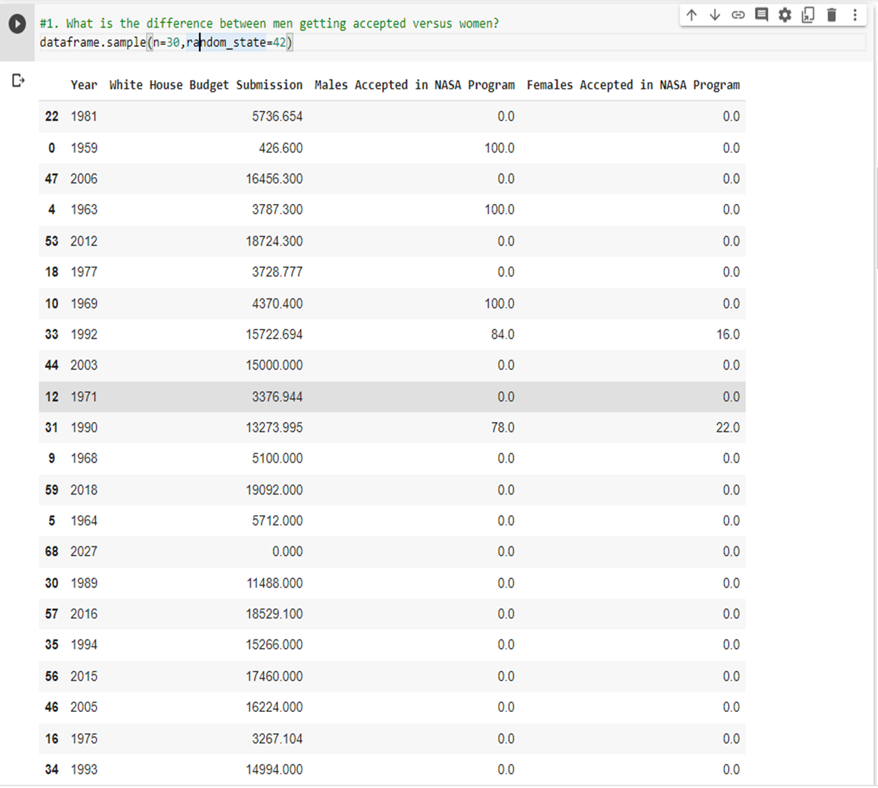
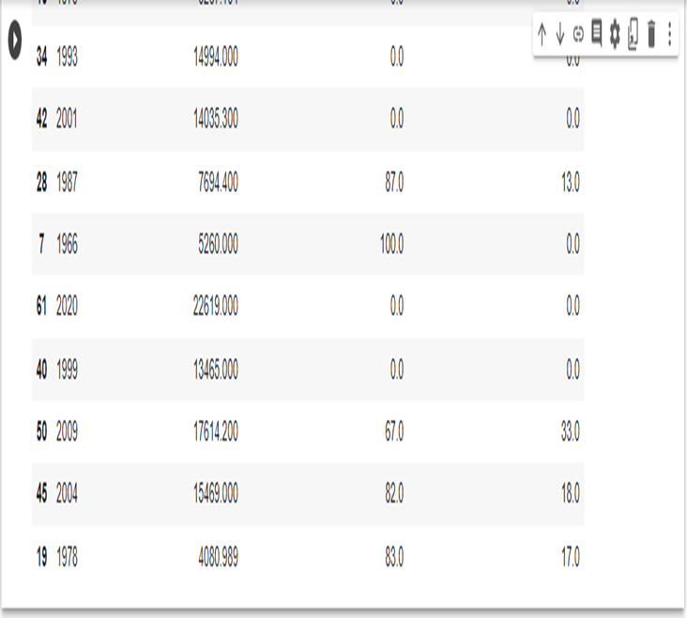
Data Frame of Budget Analysis

Slide 21
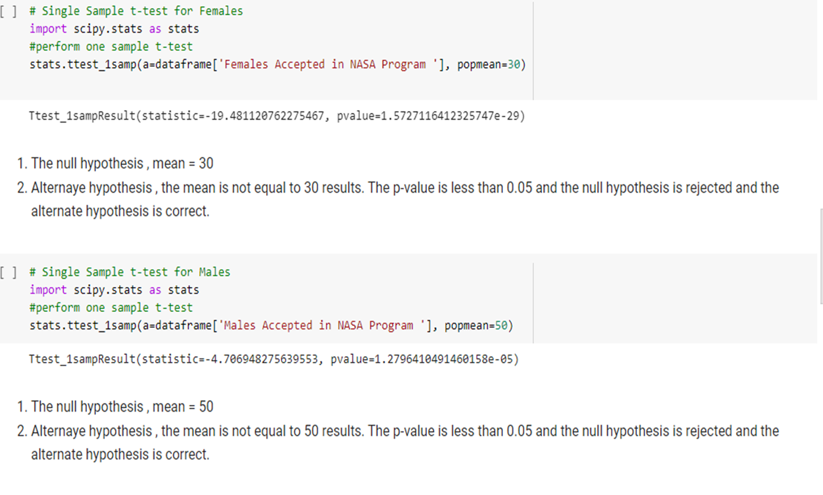
Single sample t-test for Females vs Male Budget analysis

Slide 22
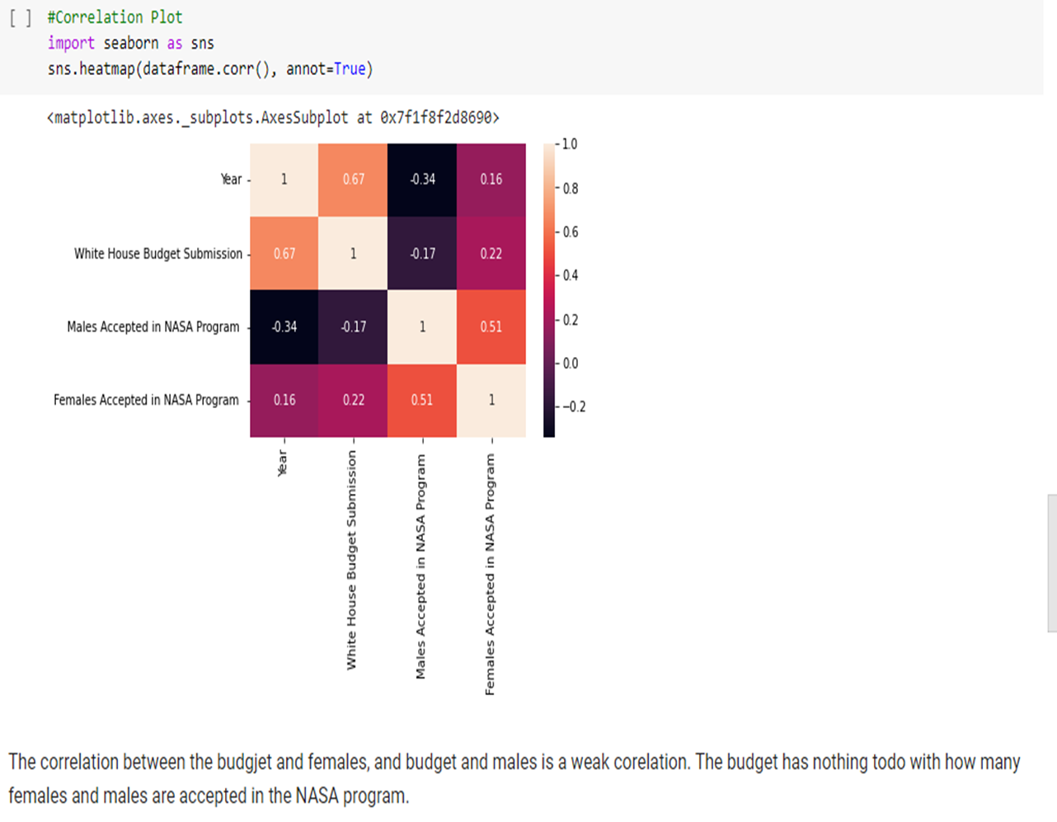
Correlation Plot

Slide 23
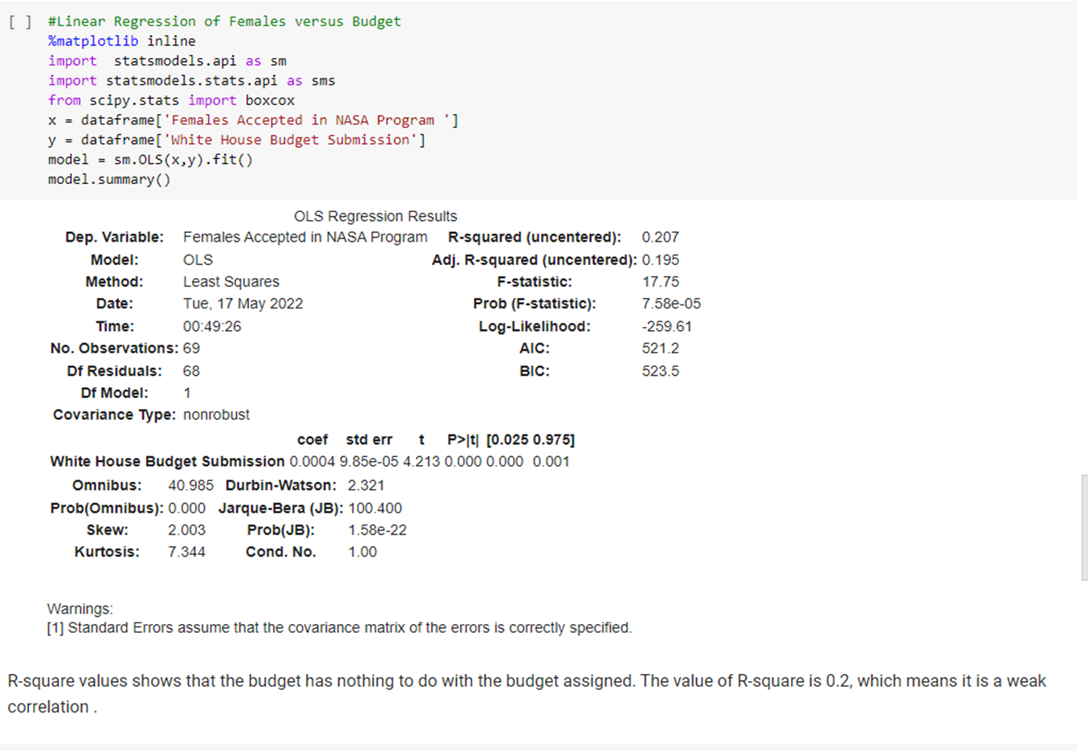
Linear Regression of Females vs. Budget

Slide 24
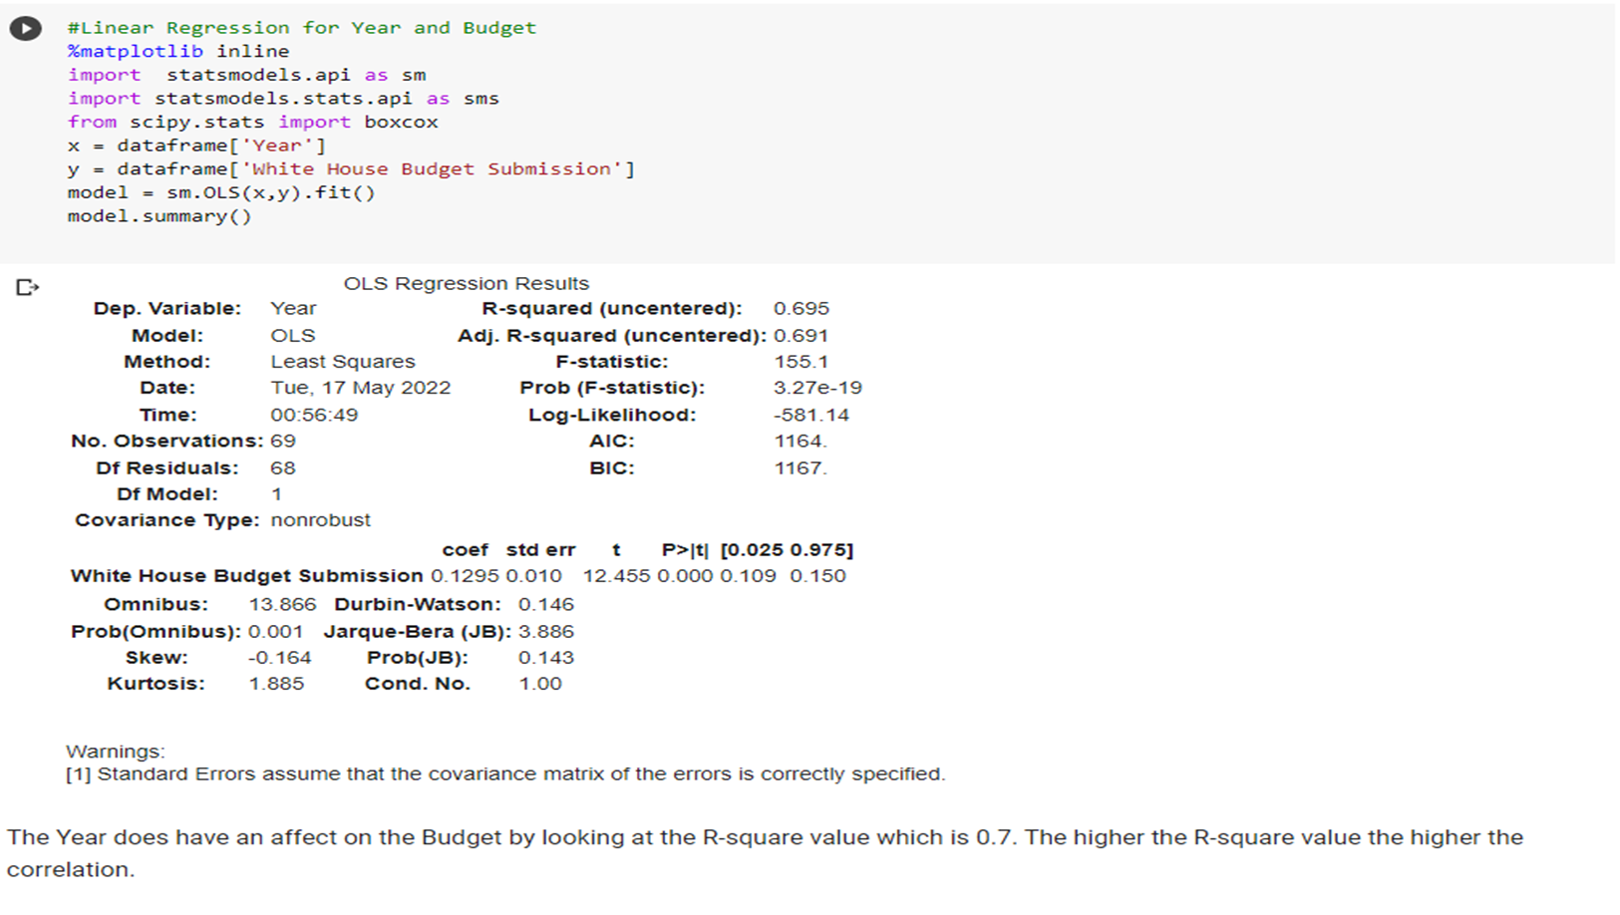
Linear Regression for Year and Budget

Slide 25
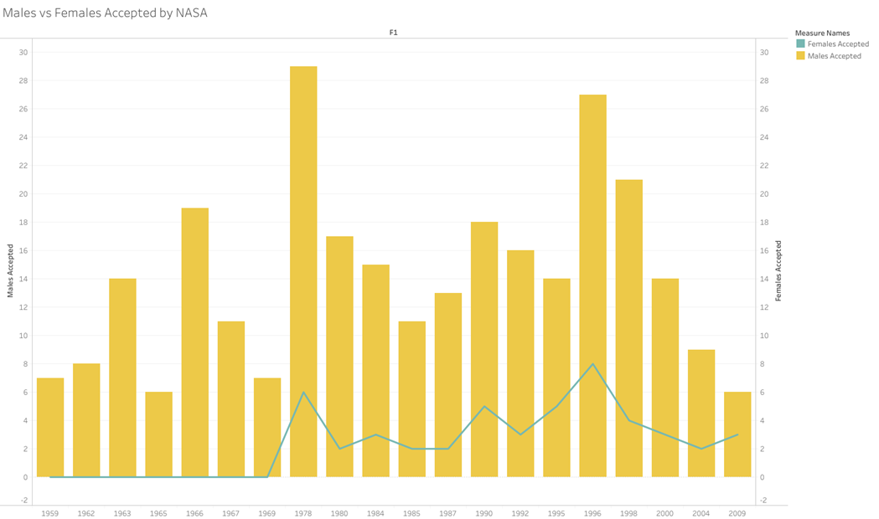
Results: Hiring Rates between Males and Females in NASA
When the NASA program was first started in 1959, it was only populated by males who had military background.
It was not until 1978 that the first females were selected as astronaut candidates
Every year from then on, the intake of females into the program are always less then those of male accepted into the NASA program

Slide 26
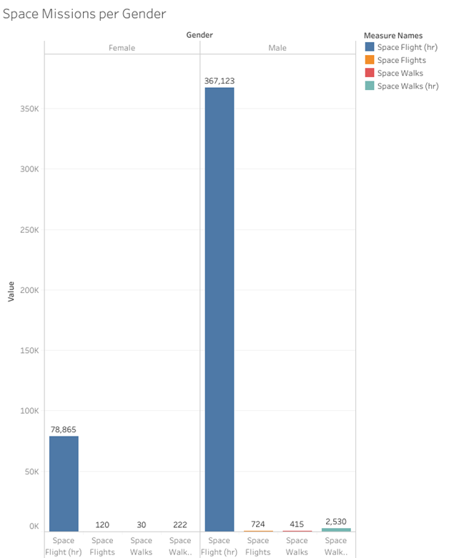
Results: Ratio of males to females that are sent on space missions
While Males had a greater number of collective hours on Space flights and Space Walks, females had a higher average of individual hours compared to number of females who were sent on missions!

Slide 27
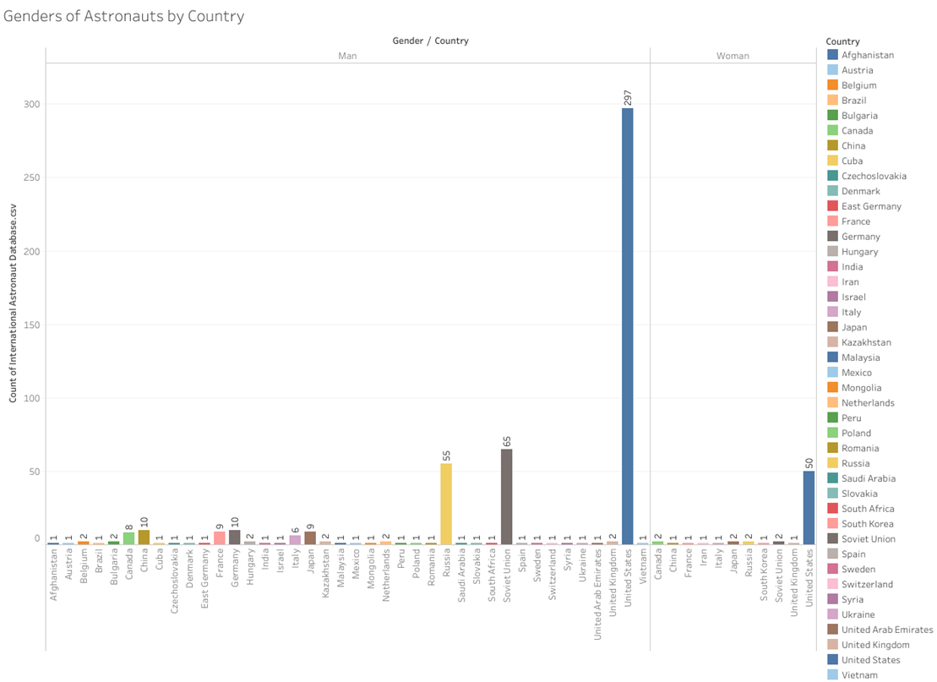
Results: Exploratory Findings
The US produces the most astronauts with the Soviet Union and Russia producing the second and third most astronauts
We also compared other countries hiring of female astronauts.
Only 9 countries hired both male and female astronauts.
2 countries (Iran and South Korea) only have females representing their countries as astronauts.

Slide 28
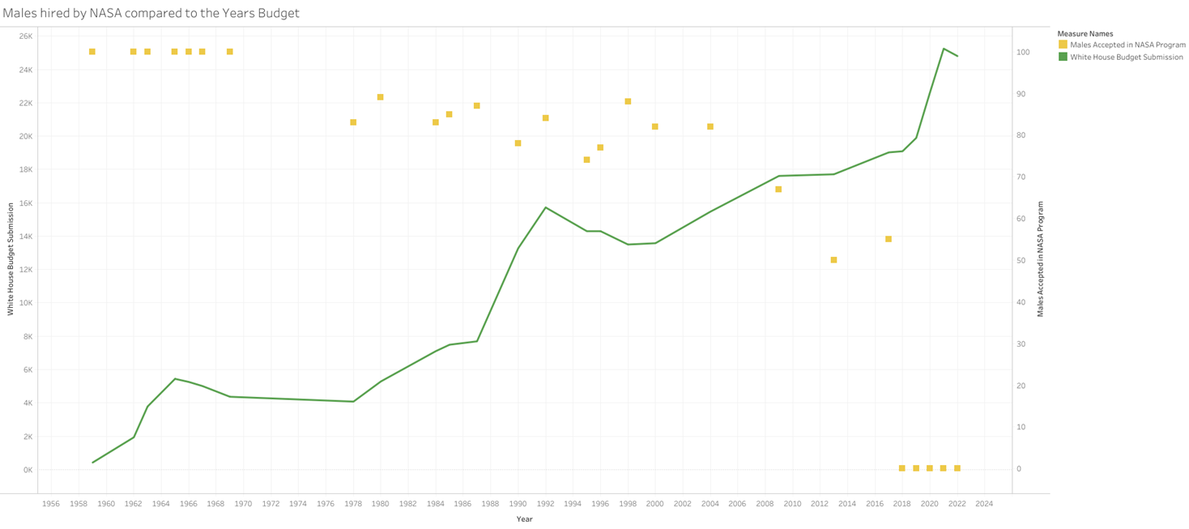
We also questioned if the budget had any influence on the hiring of males, and found that it had no significant influence on hiring practices at all.

Slide 29
Summary

Slide 30
Conclusion
How do your findings impact the world at large?
Our findings impact the world at large because it paints a picture of what an astronaut looks like and makes it
an achievable goal not just for men. In addition to this, space finding impact everyone so it is important that everyones point of view is accounted for.
What's important about this work?
This work is important because it shows that this field is not just for men but anyone with in interest in space and that there is room for everyone.
Overall:
Astronauts are becoming more and more diverse.

Slide 31
Questions?

